Slide 1

Credit Card Customers
Capstone Project 2
By Hina Motiani
Submitted to Muhammad Hamza & Faiqa Imran

Slide 2
About DATA
Data collected of credit card customers.
Manager at the bank is disturbed with more and more customers leaving their credit card services.
This dataset contains 10,000 customers mentioning their age, salary, marital_status, credit card limit, credit card category, Gender etc.

Slide 3
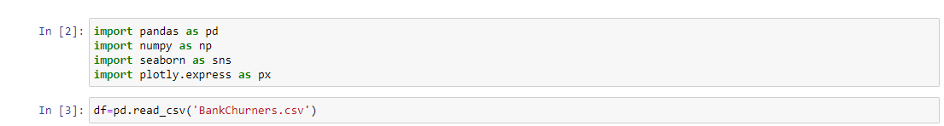
Exploratory Data Analysis - EDA understanding the data

Slide 4
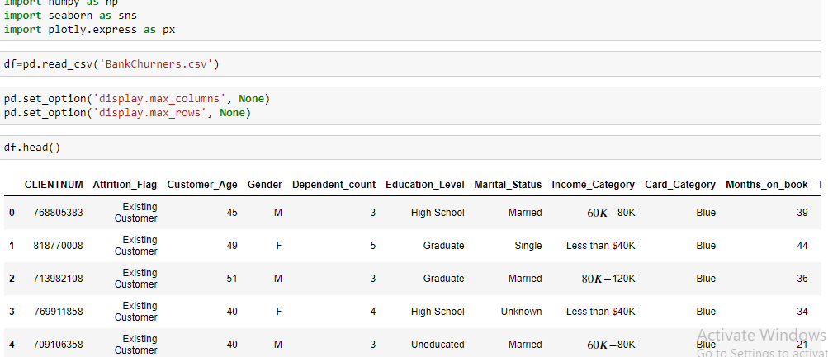
In this I have imported data and import libraries and shows first 5rows of data frame.

Slide 5
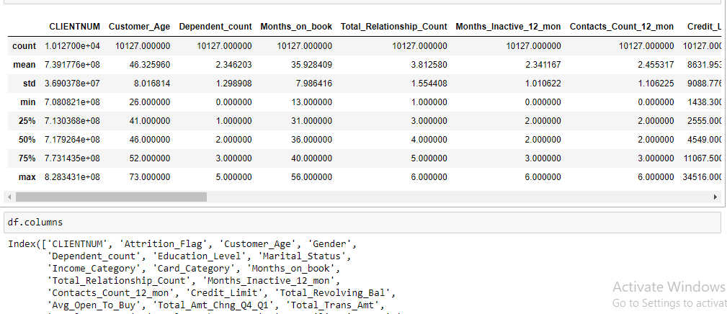
Columns are described.

Slide 6
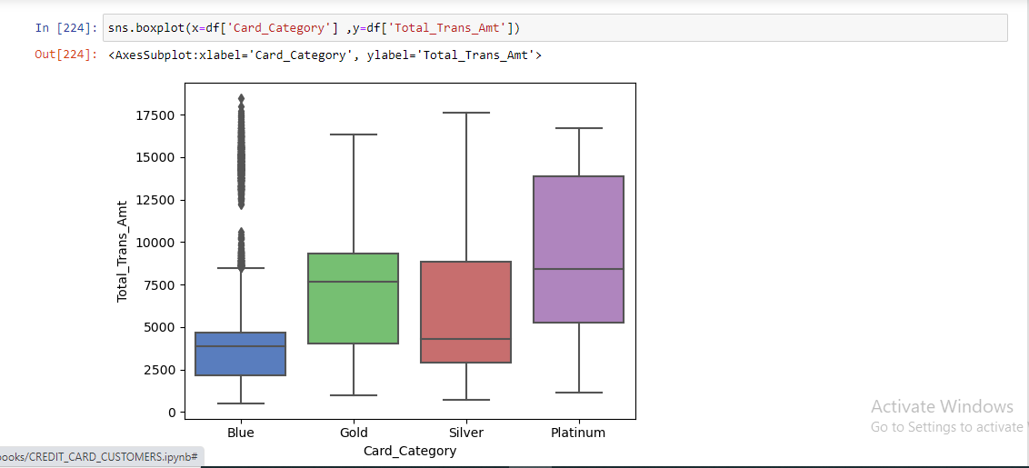
Platinum card holders performs the highest number of transactios, this is as expected, seeing that they have the highest spending ability and credit limit.

Slide 7
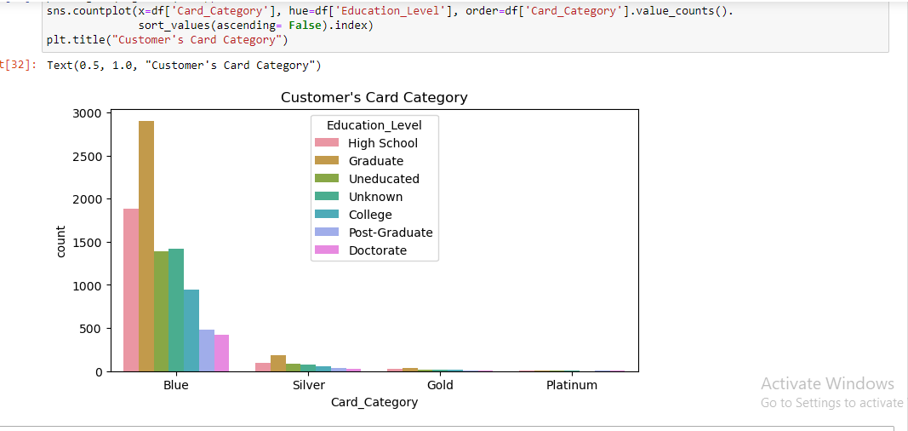
count of each card category for customers, grouped by their education level.

Slide 8
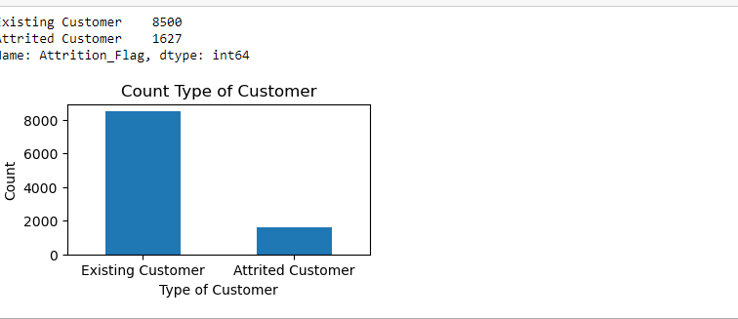
There are 8500 existing customer & 1627 are attrited.

Slide 9
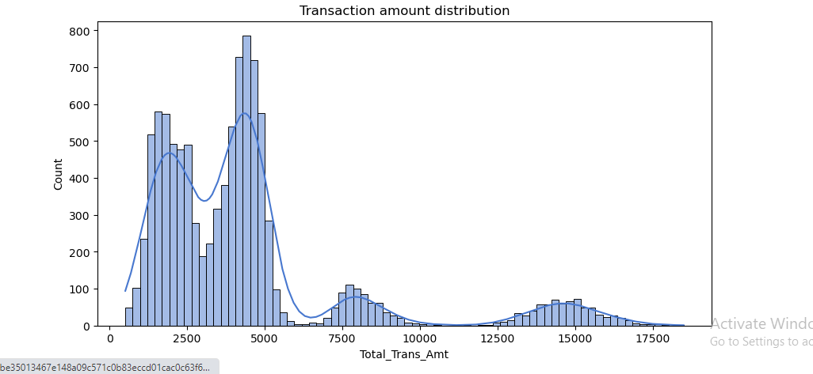
Transaction volume chart is right skewed too, most transactions are between 2k−5k. considering that fact that more credit limit to customers are within this range.

Slide 10

this graph shows Months of inactivivity in a year. In month 2 & 3 there are most inactivitity than rest.

Slide 11
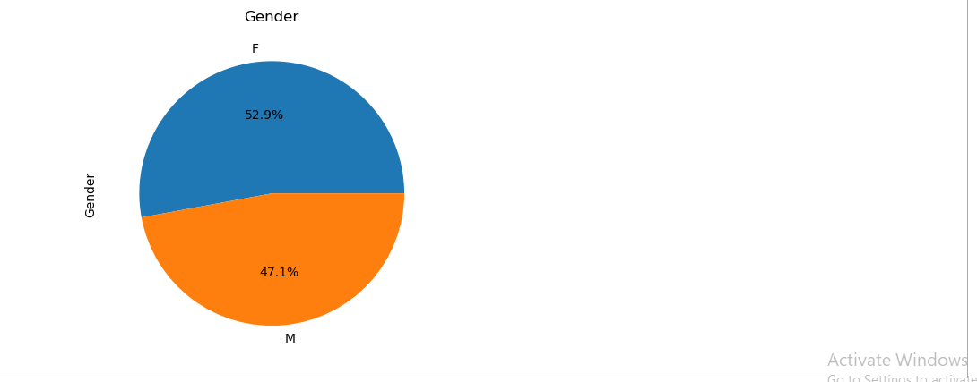
there are 52.9% female & 47.1% are males

Slide 12

Mostly people are married & single. There are less people who are divorced & unknown.

Slide 13
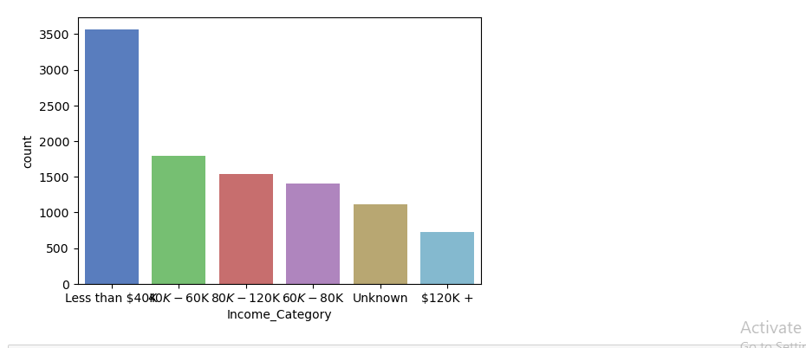
Most are fall in less than $40k income cayegory. And rest are falling arount $40 to $120k and very less people have $120k plus income.

Slide 14
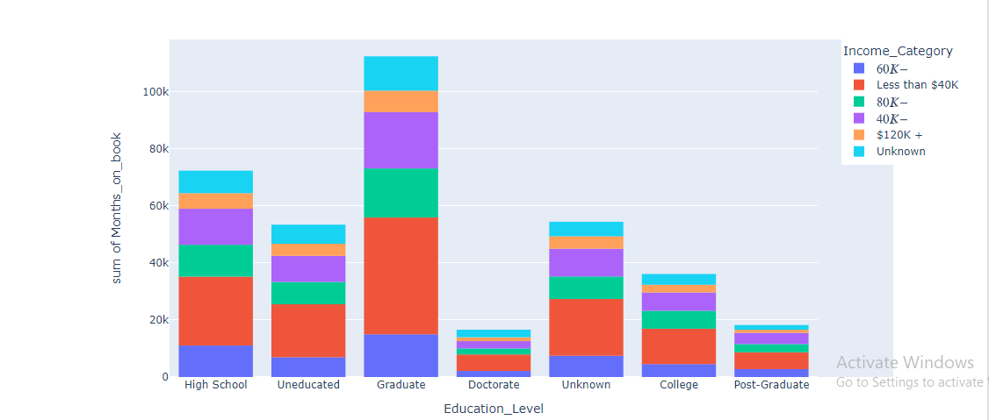
There are most people who have income level less than $40k mostly they are graduate, High school students,uneducated. most
High school students. have income level less than $40k. And some are falling $40k to $60k. Uneducated level have not earning more than $60k. As we can graduated are earning well.

Slide 15
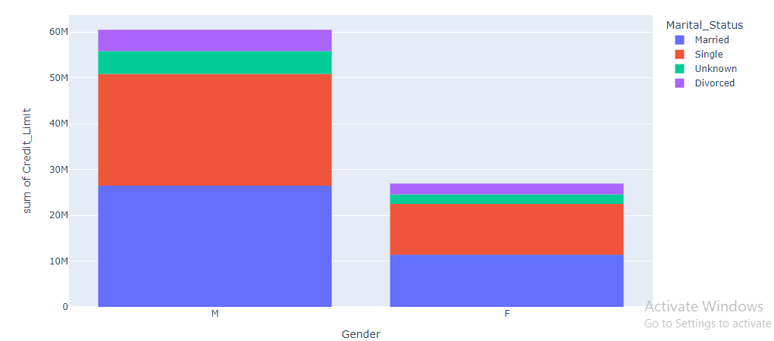
Single males have more credit limit than single female. Divorced males have around $60m credit limit. As we can see in this dataset females are more than males. But the credit limit for males are more than females.

Slide 16

Platinum card has most transactions than rest as we can see most men are using platinum card and have more credit limit than women

